Slide 1









Agenda
What is data?
What is database?
Types of database?
What is DBMS?
What is RDBMS?
What is SQL?
What is MySql?

Slide 2




WHAT IS DATA ?
Data is a collection of information.
Data can be name, age, height, phone number, picture, PDF, audio and more.

Slide 3




WHAT IS DATABASE ?
Database
A database is an electronic storage which is created by DBMS software's that stores the organized collection of records..
Databases serve as central repositories for storing and organizing vast amounts of data, providing a systematic and efficient way to access and manage information.
Data 1
Data 2
Data 3

Slide 4








Who will help me to store and organize this data
Who will help me to store and organize this data
Who will help me to store and organize this data
I Have DAta
I will help you
DBMS
I will help you

Slide 5
DATABASE
MANAGEMENT SYSTEM
A Database Management System (DBMS) is a software system that is responsible the creation, maintenance, and utilization of databases. It provides an interface for users and applications to interact with the data stored in the database, enabling efficient storage, retrieval, manipulation, and management of large volumes of structured or unstructured data.
The DBMS serves as the intermediary between the database and the users or application programs that need to access the data.

Slide 6


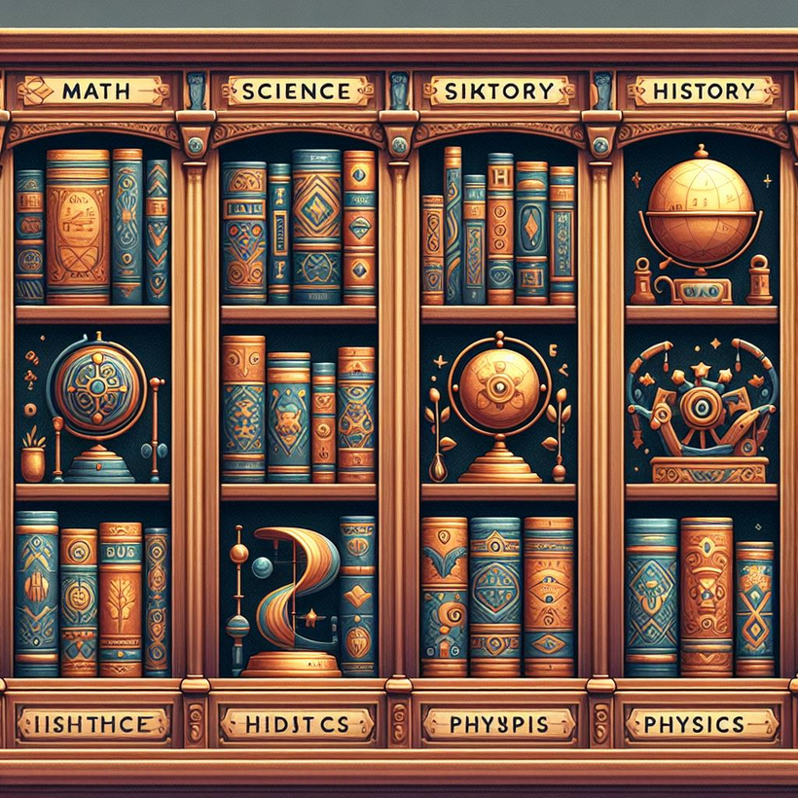

DATABASE MANAGEMENT SYSTEM
Who will help me to store and organize this data
help me to find my math book
Science
Math

Slide 7
TYPES OF DBMS?
Hierarchical databases
Network databases
Relational databases
Object-oriented databases
Graph databases
ER model databases
Document databases
NoSQL databases

Slide 8




RELATIONAL VS NOSQL
RDBMS stands for Relational Database Management System. It's a type of database management system that organizes data into tables with rows and columns.In an RDBMS, data integrity is maintained through relationships between tables, enforced by primary and foreign keys.
Relational Database
A NoSQL database, often referred to as "Not Only SQL," is a type of database that provides a mechanism for storage and retrieval of data in a format other than traditional tabular relations used in relational databases. NoSQL databases are designed to handle large volumes of unstructured or semi-structured data, offering flexibility and scalability that may be challenging to achieve with relational databases.
Nosql

Slide 9

RELATIONAL DBMS
user _id | designation
123 | Python
124 | Mysql
125 | PoweBI
Who will help me to store and organize this data
Why we are calling it relational ?
user _id | Name | city
123 | Sachin | Noida
124 | Vikas | Delhi
125 | Ajay | Pune
Who will help me to store and organize this data
Ohh They have relations among data
Who will help me to store and organize this data
coulum names are predefined

Slide 10




WHY DO WE NEED NOSQL DBMS ?
Who will help me to store and organize this data
if i have relational DBMS than why do i need Nosql?
Who will help me to store and organize this data
so i can save data without prdefined rows and columns
Who will help me to store and organize this data
all the time data can not be in same structure
{
"_id": ObjectId("60a343cbe1ab0e2a8dbfa491"),
"username": "john_doe",
"email": "john.doe@example.com",
"age": 30,
"city": "New York"
}
NoSql

Slide 11
RDBMS VS NOSQL: DATA MODELING EXAMPLE
Let's consider an example of storing information about a user and their hobbies. We need to store a user's first name, last name, cell phone number, city, and hobbies.
In a relational database, we'd likely create two tables: one for Users and one for Hobbies.
Relational
NoSQL
{
"_id": 1,
"FirstName": "John",
"LastName": "Doe",
"CellPhone": "123-456-7890",
"City": "New York",
"Hobby": ["Reading", "Cooking", "Traveling"]
}
UserID | FirstName | LastName | City
1 | John | Doe | Delhi
HobbyID | UserID | Hobby
1 | 1 | Reading
2 | 1 | Cooking
3 | 1 | Traveling

Slide 12






EXAMPLE OF RDBMS ?
Who will help me to store and organize this data
more options available beyond these listed

Slide 13






EXAMPLE OF NOSQL ?
Who will help me to store and organize this data
more options available beyond these listed

Slide 14


But how will we perform action in DBMS
Structured Query Language
DBMS
I will help you

